Slide 1
L.O. 2 . CREATE A WEB STRUCTURE
I.C.6 Managing page layout in HTML

Slide 2
1. Definition of page layout
A page layout or website layout is the arrangement of all visual elements on a webpage.
HTML layouts provide a way to arrange web pages in well-mannered, well-structured, and in responsive form or we can say that HTML layout specifies a way in which the web pages can be arranged. Web-page layout works with arrangement of visual elements of an HTML document.

Slide 3
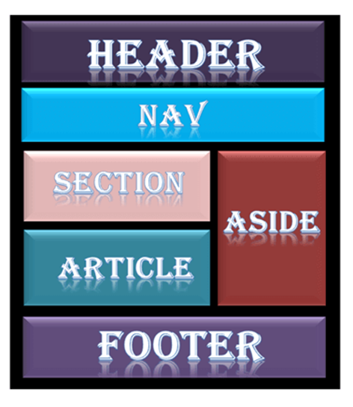
Parts of webpage

Slide 4
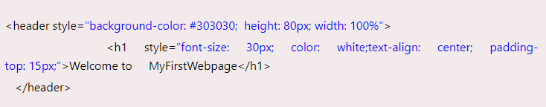
Description of various Layout elements
1. HTML <header>
The <header> element is used to create header section of web pages. The header contains the introductory content, heading element, logo or icon for the webpage, and authorship information.
Example:

Slide 5
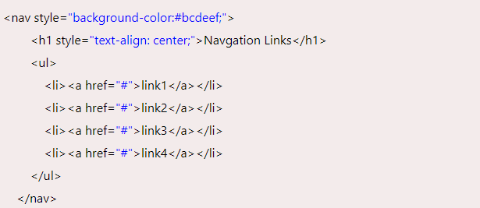
2. HTML <nav>
The <nav> elements is a container for the main block of navigation links. It can contain links for the same page or for other pages.
Example:

Slide 6
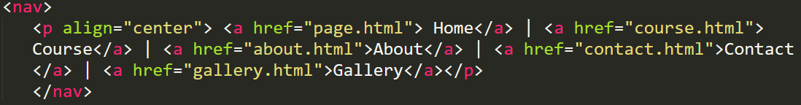
Example 2.

Slide 7
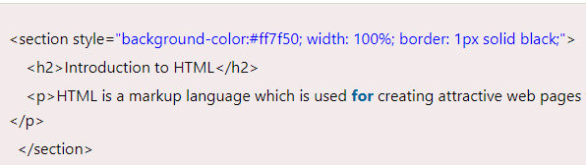
3. HTML <section>
HTML <section> elements represent a separate section of a web page which contains related element grouped together. It can contain: text, images, tables, videos, etc.

Slide 8
4. HTML <article>
The HTML tag is used to contain a self-contained article such as big story, huge article, etc.
Example:
<article style="width: 100%; border:2px solid black; background-color: #fff0f5;">
<h2>History of Computer</h2>
<p>Write your content here for the history of computer</p>
</article>

Slide 9
6. HTML <footer>
HTML <footer> element defines the footer for that document or web page. It mostly contains information about author, copyright, other links, etc.
Example:
<footer style="background-color: #f0f8ff; width: 100%; text-align: center;">
<h3>Footer Example</h3>
<p>© Copyright 2023-2024. </p>
</footer>

Slide 10
HTML <details>
HTML <details> element is used to add extra details about the web page and use can hide or show the details as per requirement.
Example:
<details style="background-color: #f5deb3">
<summary>This is visible section: click to show other details</summary>
<p>This section only shows if user want to see it. </p>
</details>

Slide 11
HTML <summary>
HTML <summary> element is used with the <details> element in a web page. It is used as summary, captions about the content of <details> element.
Example:
<details>
<summary>HTML is acronym for?</summary>
<p style="color: blue; font-size: 20px;">Hypertext Markup Language</p>
</details>

Slide 12
HTML <aside>
HTML <aside> define aside content related to primary content. The <aside> content must be related to the primary content. It can function as side bar for the main content of web page.
The <aside> element in HTML is used to define content that is tangentially related to the content around it. It is typically used for content that is considered separate from the main content of the document but still related or supportive.

Slide 13
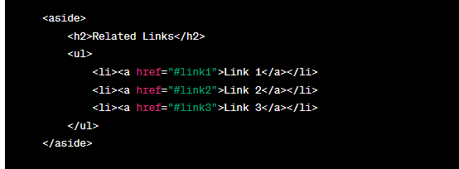

Slide 14
Example
<aside style="background-color:#e6e6fa">
<h2>Sidebar information</h2>
<p>This contains information which will represent like a side bar for a webpage</p>
</aside>

Slide 15
Optimizing webpage in HTML
Definition: Website optimization is the process of using tools, advanced strategies, and experiments to improve the performance of your website, further drive more traffic, increase conversions, and grow revenue.

Slide 16
A holistic website optimization approach combines a variety of disciplines to make sure your website performs ideally in all areas:
SEO
Copywriting
Analytics
UX Design (Frontend)
Web Development (Backend)
CRO/Landing Page Optimization.

Slide 17
Cont’
SEO:
Search Engine Optimization (SEO) is a set of practices aimed at improving a website's visibility on search engines like Google, Bing, and Yahoo.
Copywriting
is the art and science of creating written content (copy) with the primary goal of persuading, engaging, or motivating a target audience to take a specific action. Whether used in advertising, marketing, or any form of communication, effective copywriting is essential for conveying a message that resonates with the intended audience.

Slide 18
Analytics and Monitoring: Use tools like Google Analytics to monitor website performance.
UX Design (Frontend) :UX design is considered a front-end service because it focuses on the user's needs, their interactions with the product, and how to make those experiences as intuitive and enjoyable as possible
Web Development (Backend) :The backend (or “server side”) is the portion of the website you don't see. It's responsible for storing and organizing data, and ensuring everything on the client-side actually works.
CRO/Landing Page Optimization: Conversation Rate Optimization: helps create an experience that resonates with visitors and converts them into paying customers.

Slide 19
Use HTML tags to optimize webpage
Meta
Title
Heading
Image alt

Slide 20
1. Meta Description: <meta name="description" content="Description of the page"> - Provides a brief summary of the page's content. While it doesn't directly impact rankings, a well-crafted meta description can improve click-through rates from search results.
2. Title Tag: <title> - Specifies the title of the webpage displayed in search engine results and browser tabs. It's crucial for SEO and should be descriptive and relevant to the page content.
3. Heading Tags: <h1> to <h6> - Used to structure content hierarchically. <h1> is the main heading and should represent the primary topic, followed by subheadings <h2>, <h3>, and so on, to organize content logically.

Slide 21
Con’t
4. Image Tags: <img src="image.jpg" alt="Description"> - Images should have descriptive alt attributes for accessibility and SEO. It helps screen readers understand the image content and provides information when the image can't be displayed.

Slide 22
HTML semantic tags
A semantic element clearly describes its meaning to both the browser and the developer
The semantic elements added in HTML5 are:
<article> <aside> <details> <figcaption> <figure> <footer>
<header> <main>

Slide 23
Web accessibility:
Web accessibility means that websites, tools, and technologies are designed and developed so that people with disabilities can use them. More specifically, people can: perceive, understand, navigate, and interact with the Web.
Web accessibility refers to the practice of ensuring that websites, applications, and digital content are designed and developed to be usable and accessible to all people, including those with disabilities

Slide 24
HTML Role
In HTML (Hypertext Markup Language), the role attribute is used to define the role or purpose of an element in the context of a web page. The role attribute is part of the broader effort to enhance web accessibility by providing additional information to assistive technologies, such as screen readers, in interpreting and presenting content to users with disabilities

Slide 25
Purpose of the role Attribute
The role attribute is used to convey the intended role or function of an HTML element.
It helps assistive technologies understand the semantics of the content, making it more accessible to users with disabilities.
Common role Values
role values can vary based on the type of content and its intended function.

Slide 26
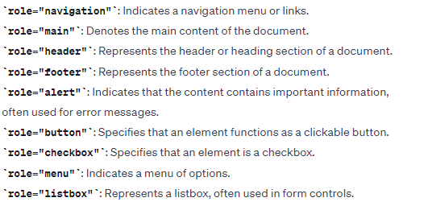
Common role values include

Slide 27
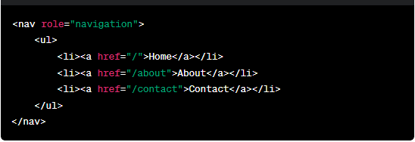
Example

Slide 28
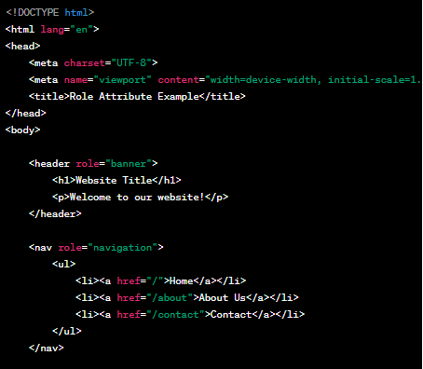

Slide 29
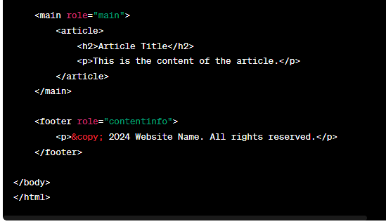

Slide 30
Test and Standard Validation
Testing and validation are critical aspects of web development to ensure that websites or web applications function correctly, adhere to standards, and provide a positive user experience.
Two primary types of testing and validation in web development are
Functional Testing
Standard Validation

Slide 31
1. Functional Testing
1.Unit Testing: This involves testing individual components or functions of the code to ensure they work as expected.
2. Integration Testing: Verifies that different components or modules work together as intended when integrated.
3. System Testing: Examines the entire system or application to ensure all components work together in the intended environment.
4.User Acceptance Testing (UAT): Involves end-users testing the application to validate that it meets their requirements.

Slide 32
2. Standard Validation
1. HTML Validation: Ensures that HTML code follows the rules and syntax defined by the HTML standard. Tools like the W3C Markup Validation Service can be used for this purpose.
2. CSS Validation: Validates Cascading Style Sheets (CSS) to ensure they comply with the CSS specifications. The W3C CSS Validation Service is a commonly used tool.
3. JavaScript Linting and Validation: Uses tools like ESLint or JSHint to check JavaScript code for errors, coding style, and adherence to best practices.
4. Accessibility Testing: Ensures that web content is accessible to all users, including those with disabilities. Tools like axe Accessibility Checker or WAVE (Web Accessibility Evaluation Tool) can help identify accessibility issues

